Slide 1
Python
While and For Loops

Slide 2
Iteration
Iteration allows programs to execute statements multiple times.
Python provides built in supports for two different kinds of iteration statements:
    the while loop
    the for loop

Slide 3
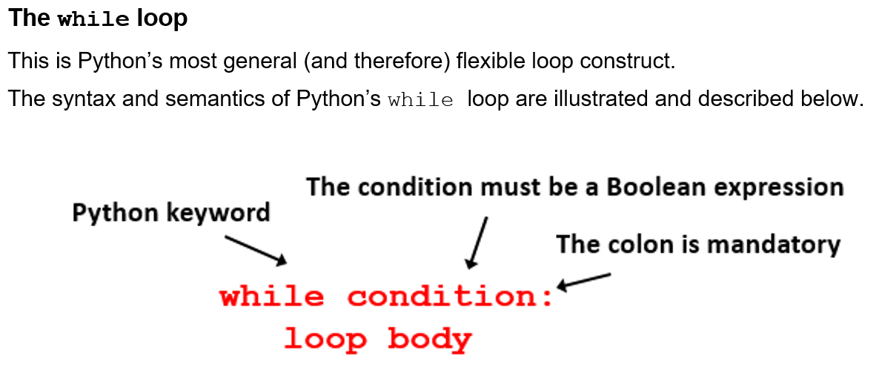
While Loop

Slide 4
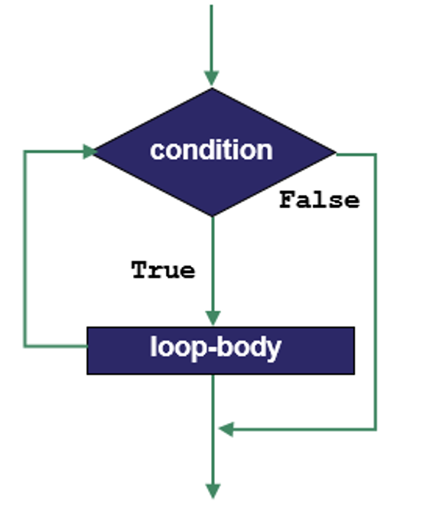
Flowchart of the while loop

Slide 5
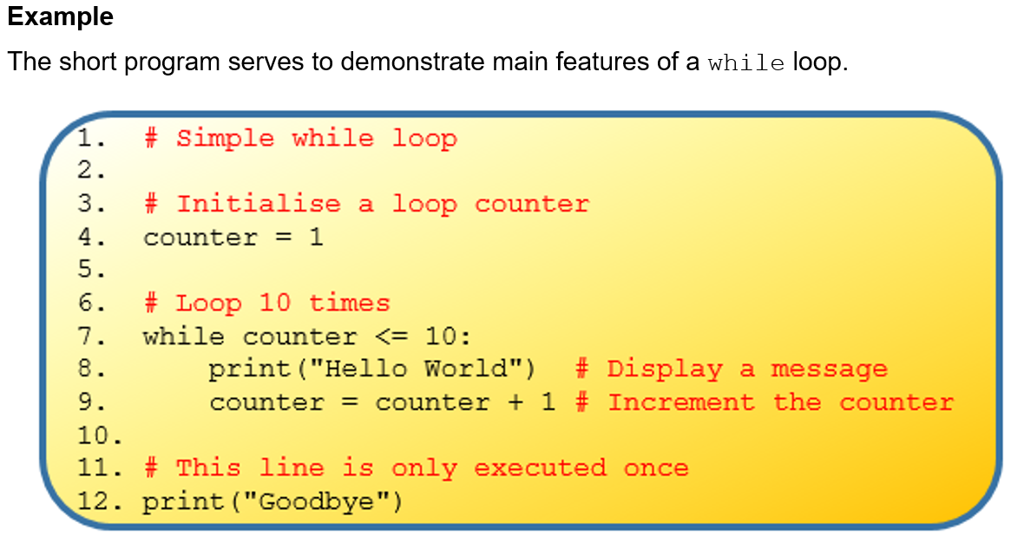

Slide 6
Video on while loops
https://vimeo.com/showcase/5120220

Slide 7
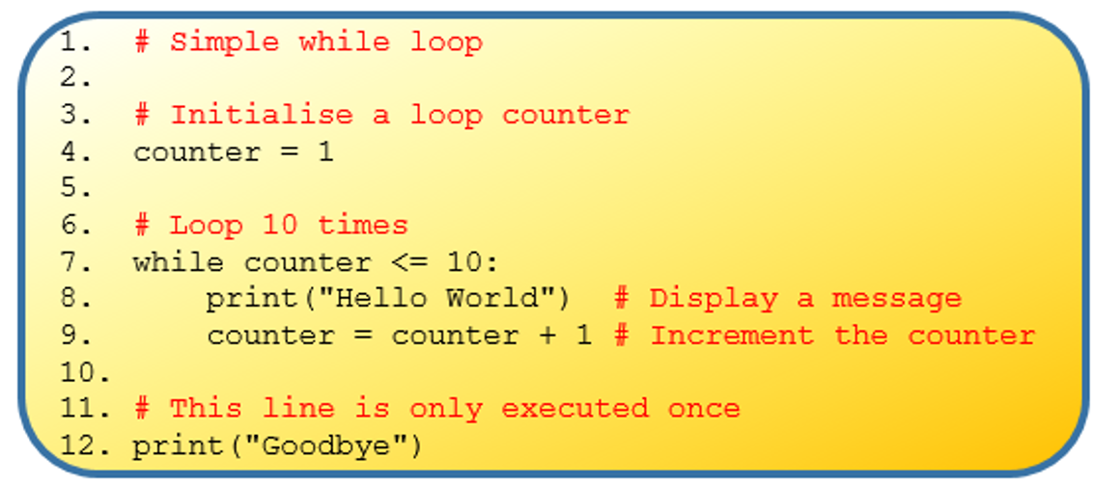
Complete Task 1 in worksheet

Slide 8
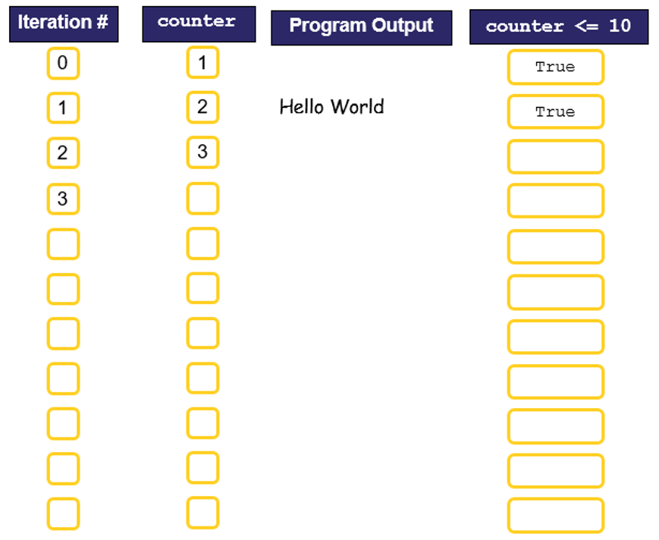
Complete Task 2 in worksheet

Slide 9
Complete Task 3 – Use the test case below for testing
INPUT | OUTPUT | EXPECTED OUTPUT | PASS YES/NO
1
2
3
4
5
6
7
8
9
10
0

Slide 10
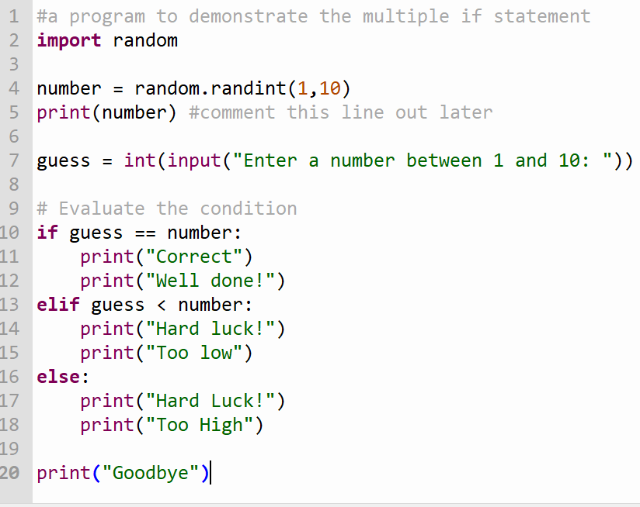
Guessing Game Version 3

Slide 11
Guessing Game Version 4
Enhance the guessing game to give the user three chances.
Version 3 of the program works properly for one chance.
Wrap the code from version 3 inside a while loop that runs three times.

Slide 12
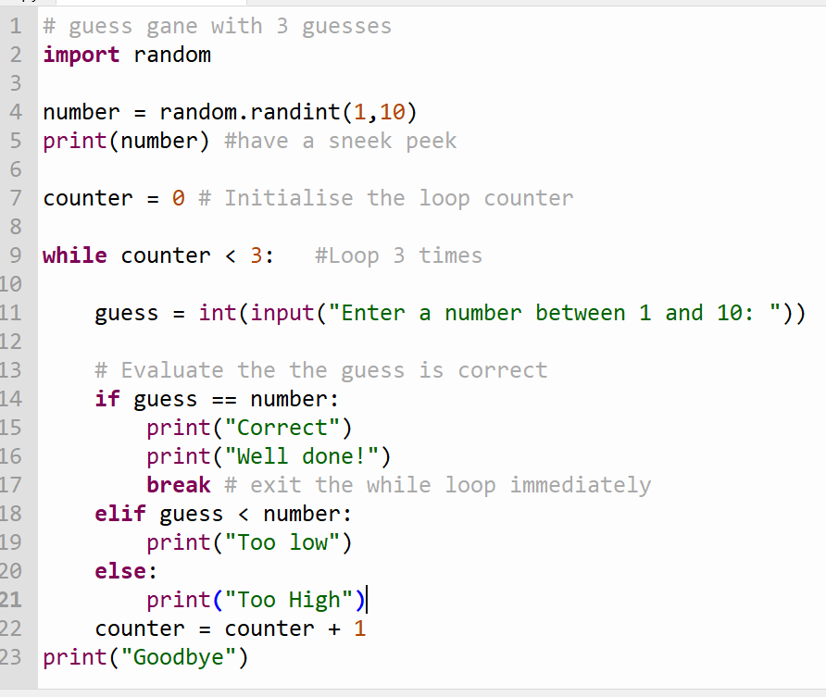
Guessing Game Version 4

